Slide 1

ALGOA RECONCILIATION STRATEGY STEERING COMMITTEE
18 April 2018

Slide 2

INTRODUCTION
Agenda Items for feedback:
8.1 NMBM water requirements
11.1 NMBM Drought measures and progress with implementation
11.2 WC/WDM at NMBM
11.3 Nooitgedagt Low-level Scheme Implementation and Financing
11.4 Desalination of Sundays River irrigation return flows.
11.5 Re-use of water treated to industrial standards:
  Fish Water Flats WWTW
  Coega WWTW
11.6 Groundwater - Coega Kop implementation
11.7 Other groundwater schemes & drought initiatives
11.8 NMBM 60 Ml/d Desalination Scheme
11.9 Marina Sea Salt Desalination Scheme

Slide 3
8.1 NMBM water requirements:
The water requirements for the NMBM remains in terms of the current licence abstraction from the various resources.
2005 WMP anticipated a water requirement of 390 Ml/d.
Projects to support increased demand:
  NCLLS Phase 3: 70 Ml/d
  Ground Water Coega: 15-20 Ml/d
  NRW reduction: ±20 Ml/d

Slide 4
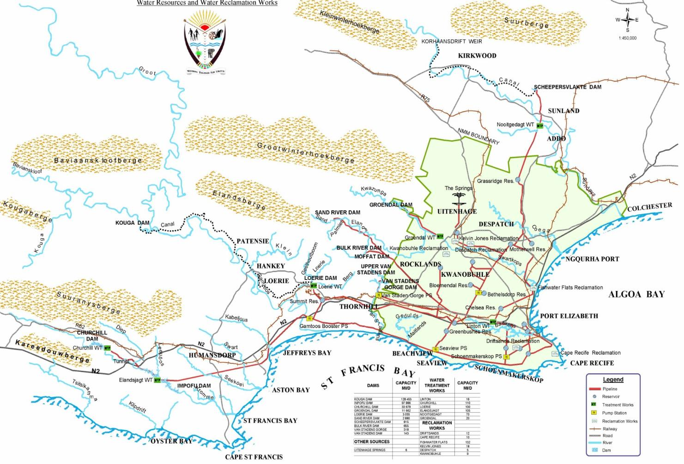

NMBM: Potable Water Bulk Supply System
Orange / Fish System
Nooitgedagt
Groendal
Sand & Bulk
Loerie
Groundwater
Churchill & Elandsjagt

Slide 5
11.1 NMBM Drought measures and progress with implementation
National drought declaration 13 February 2018.
R97mil funding received on 28 March 2018.
Approval received for the following projects:
  Coega Kop Wellfields, drilled - 10%, equip 10%
  Moregrove fault line boreholes, drilled - 50%, equip - 0%
  Uitenhage boreholes, drilled - 10%, equip - 0%
  Churchill boreholes, drilled 10%, equip - 0%
  Health facilities, drilled 20%, equip - 5%
Maximising of Nooitgedagt 210Ml water

Slide 6
FINANCIAL IMPLICATIONS OF INTERVENTIONS
No | DESCRIPTION | COST ESTIMATE
1 | Increased Efficiency in Operations and Maintenance | R22,000,000
2 | Day Zero (6months) and Drought Awareness Campaigns | R10,000,000
3 | Water Conservation / Water demand Management | R107,000,000
4 | Nooitgedagt optimisation & temporary treatment | R21,000,000
5 | Implementation of ground water schemes. | R255,000,000
6 | Accessing Dead Storage in Dams | R7,000,000
7 | Improvements of the Older Dams System | R18,000,000
8 | Ward Boreholes (30 Wards @ 3 each = 90) | R21,060,000
9 | Desalination Plants | R1,760,500,000
 | Totals | R2,221,560,000

Slide 7
Historical Dam levels
Month | Kouga (%) | Churchill (%) | Impofu (%) | Loerie (%) | Groendal (%) | Total (%)
July 2016 | 65.38 | 63.45 | 83.93 | 33.58 | 80.15 | 72.58
August 2016 | 66.13 | 59.83 | 83.51 | 21.05 | 78.09 | 71.88
September 2016 | 65.8 | 60.71 | 82.93 | 23.83 | 79.12 | 71.70
October 2016 | 61.52 | 55.13 | 80.76 | 20.85 | 76.72 | 68.14
November 2016 | 55.76 | 49.57 | 79.18 | 20.26 | 73.71 | 64.17
December 2016 | 47.37 | 41.94 | 76.54 | 20.46 | 68.90 | 58.25
January 2017 | 40.88 | 35.13 | 73.98 | 32.55 | 65.81 | 53.53
February 2017 | 34.18 | 28.40 | 71.39 | 45.51 | 62.80 | 48.74
March 2017 | 28.38 | 20.88 | 69.32 | 41.54 | 59.02 | 44.23
April 2017 | 24.33 | 15.76 | 66.98 | 34.93 | 56.44 | 40.24
May 2017 | 20.74 | 12.35 | 64.63 | 55.98 | 54.81 | 37.85
June 2017 | 18.36 | 9.70 | 61.07 | 30.27 | 52.32 | 34.85
July 2017 | 15.18 | 7.67 | 58.30 | 29.44 | 49.14 | 31.99
August 2017 | 14.82 | 10.01 | 55.97 | 74.12 | 49.66 | 31.75
September 2017 | 14.18 | 12.90 | 53.75 | 92.86 | 52.06 | 31.29
October 2017 | 12.23 | 13.92 | 50.90 | 88.73 | 52.84 | 29.47
November 2017 | 12.59 | 20.79 | 48.58 | 99.14 | 54.21 | 29.79
December 2017 | 9.77 | 20.33 | 45.49 | 84.43 | 53.95 | 27.13
January 2018 | 10.13 | 18.91 | 43.30 | 84.27 | 51.29 | 26.19
January 2017 | 40.88 | 35.13 | 73.98 | 32.55 | 65.81 | 53.53
% change | 30.75 | 16.22 | 30.68 | -51.72 | 14.52 | 27.34

Slide 8
Overall Monthly Storage Capacities
MONTH | AVE. DAM LEVELS | %CHANGE | AVE MONTHLY CONSUMPTION (Mℓ/d)
July 2016 | 72.58 | - 1.43 | 307.91
August 2016 | 71.88 | - 0.70 | 314.77
September 2016 | 71.70 | - 0.18 | 305.60
October 2016 | 68.14 | - 3.56 | 301.73
November 2016 | 64.17 | - 3.97 | 303.73
December 2016 | 58.25 | - 5.92 | 303.01
January 2017 | 53.53 | - 4.72 | 293.53
February 2017 | 48.74 | - 4.79 | 293.02
March 2017 | 44.23 | - 4.51 | 288.00
April 2017 | 40.24 | - 3.99 | 284.02
May 2017 | 37.85 | - 2.39 | 258.99
June 2017 | 34.85 | - 3.00 | 267.60
July 2017 | 31.99 | - 2.86 | 275.56
August 2017 | 31.75 | - 0.24 | 273.19
September 2017 | 31.29 | - 0.46 | 281.00
October 2017 | 29.47 | - 1.82 | 271.16
November 2017 | 29.79 | - 0.32 | 280.99
December 2017 | 27.13 | - 2.66 | 287.68
January 2018 | 26.19 | - 0.94 | 288.33

Slide 9
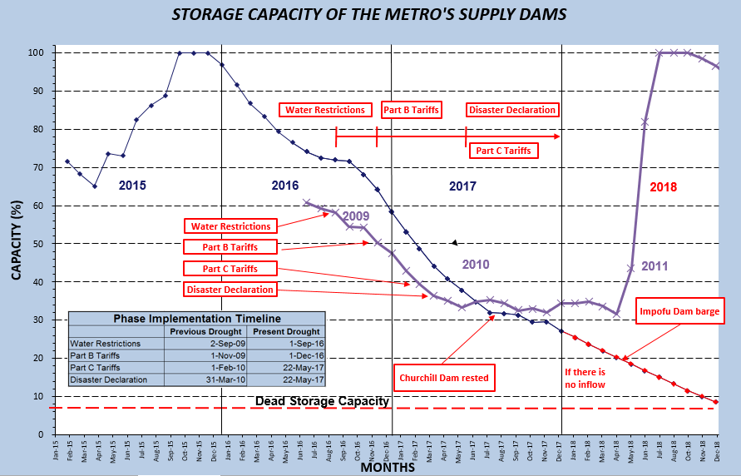

Slide 10
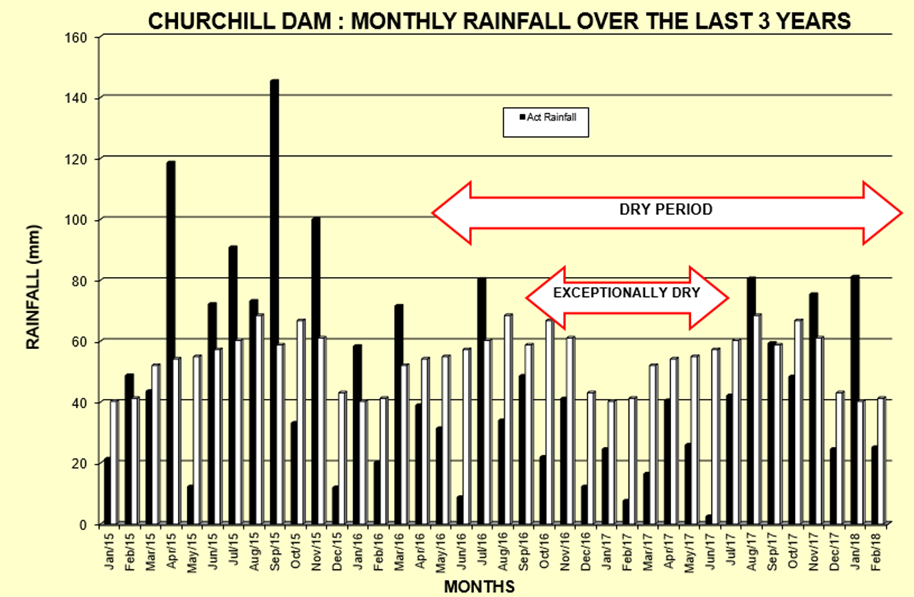
20 Year Rainfall Data at Churchill Dam

Slide 11
Langkloof catchment

Slide 12
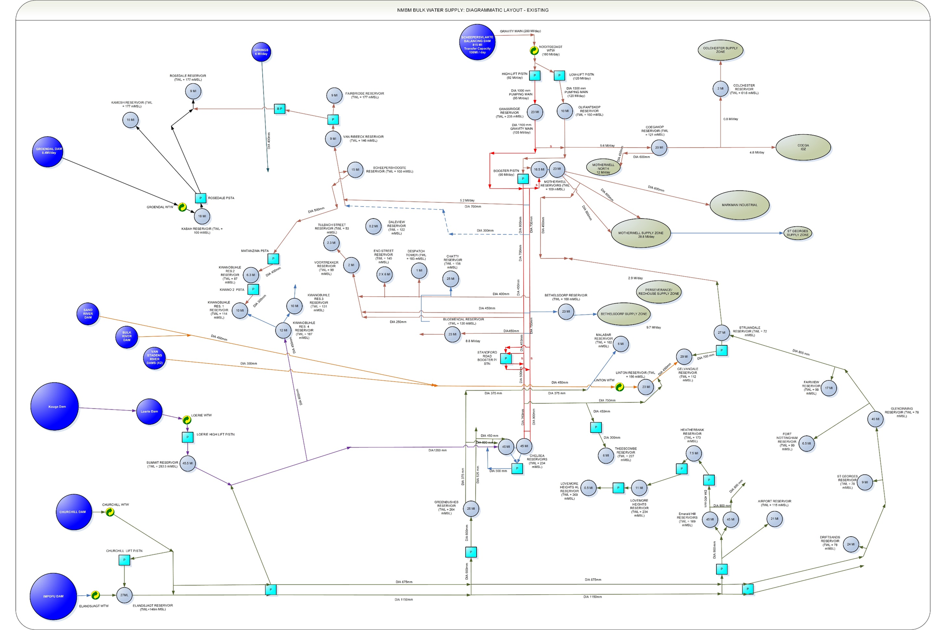

Slide 13
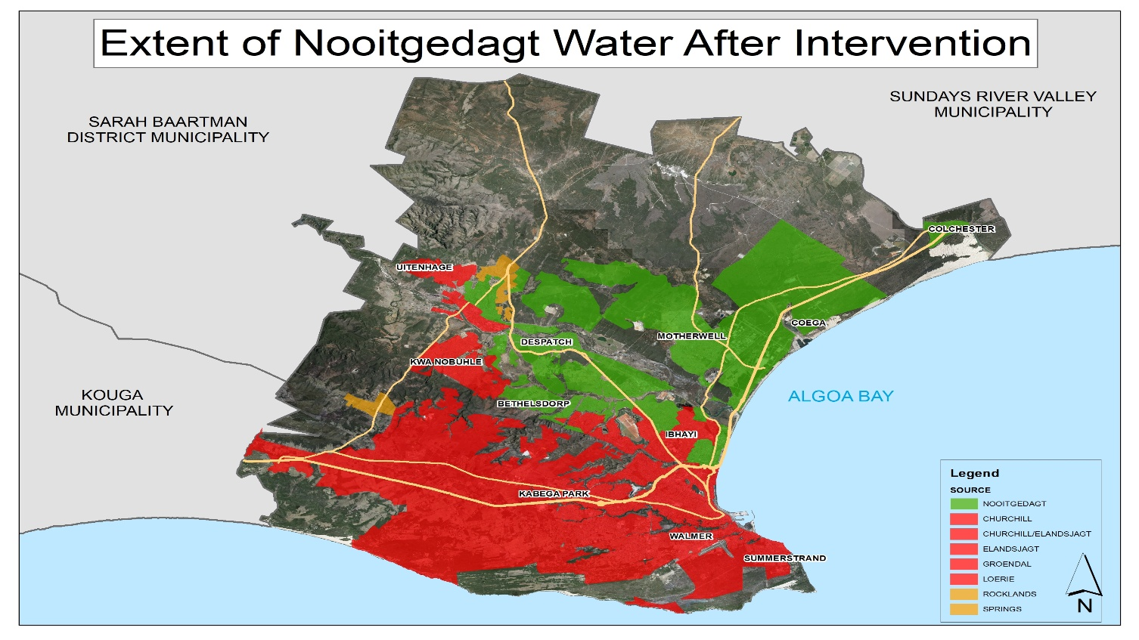
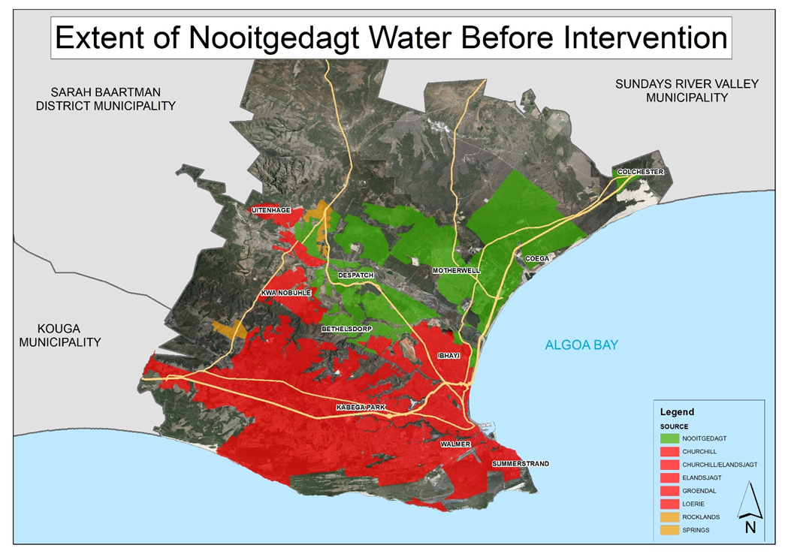

Slide 14
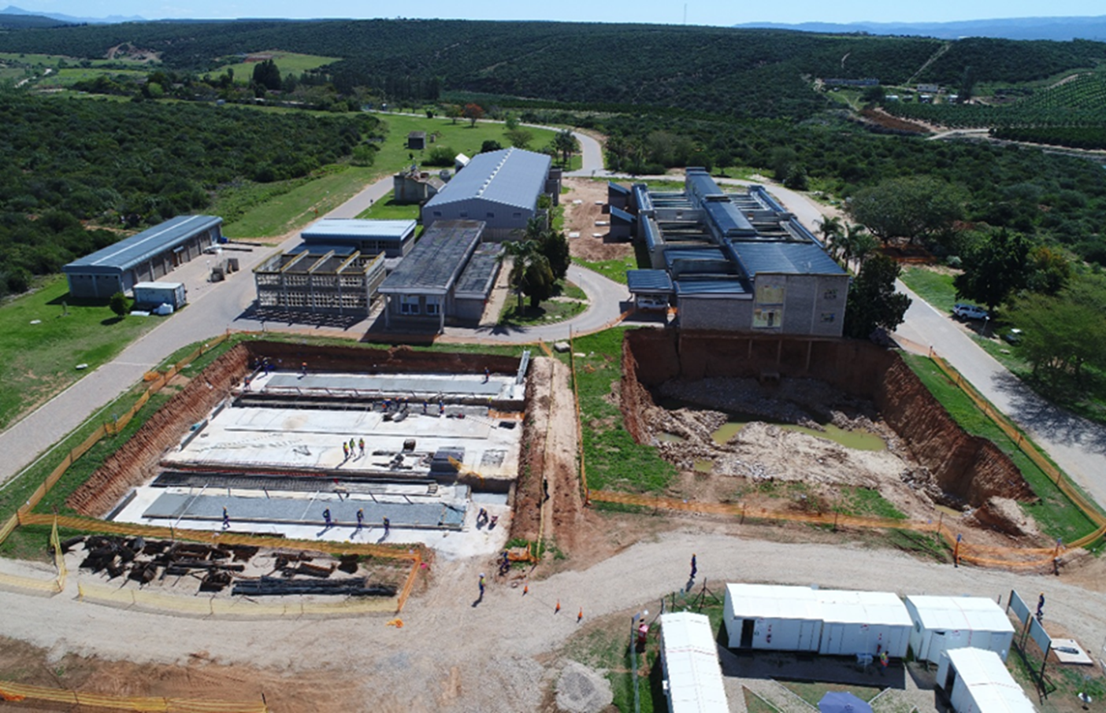
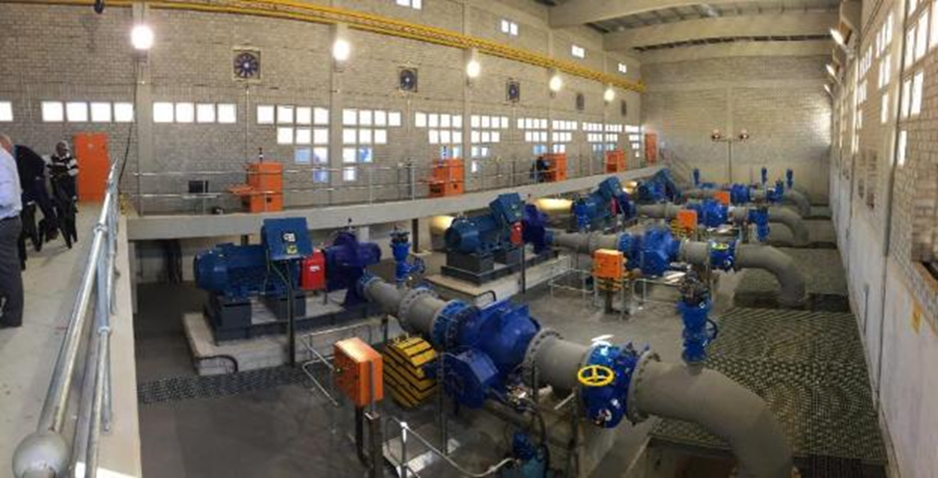
DROUGHT MITIGATIONS
Nooitgedagt optimisation & temporary treatment
  Optimisation:
    Stanford Rd booster transferring ± 60 Ml/d.
    Increase Chelsea Res. zone into Lorraine / Fairview / Charlo.
    Increase Motherwell Res. Zone into New Brighton / Deal Party.
    Increase the supply into Uitenhage / KwaNobuhle.
    Pump station to Despatch Tower.
    Pump station Chelsea Res to KwaNobuhle

Slide 15
DROUGHT MITIGATIONS
Nooitgedagt optimisation & temporary treatment (cont.):
  Temporary Treatment:
    Nooitgedagt: 140 Ml/d Treatment & 210 Ml/d Pumping Capacity.
      70Ml/d spare pumping capacity.
    Temporary Treatment Plant at Grassridge Reservoir:
      Treating of 70 Ml/d spare capacity that can be pumped.
      Reintroduced 1992 Drought Plan.
      Pipe interconnections currently being carried out.
      Sedimentation & disinfection.
    Water then gravitates to Motherwell pumpstation where it is blended with the remaining 140 from the low level scheme before distribution to customers.

Slide 16
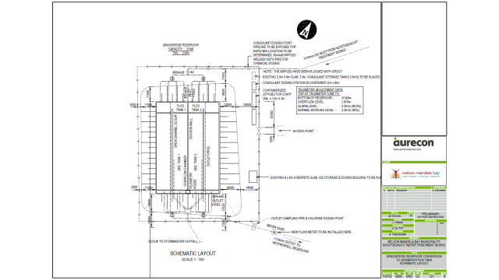

Slide 17
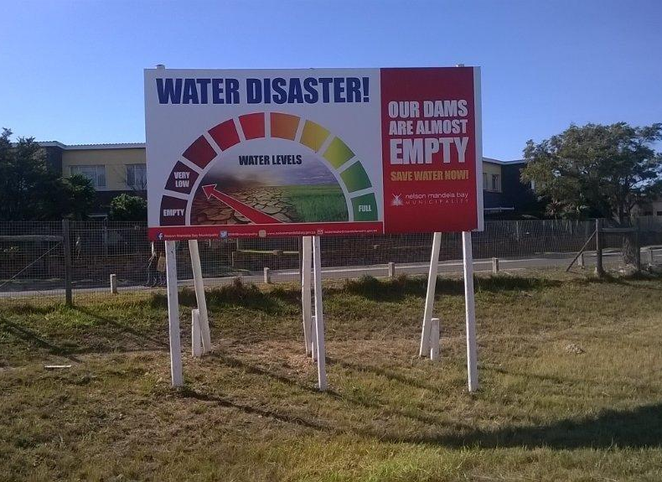
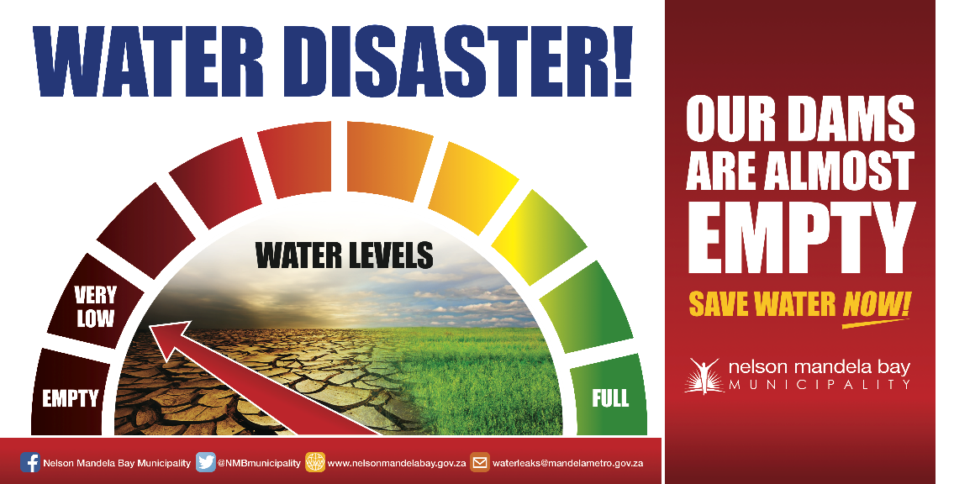
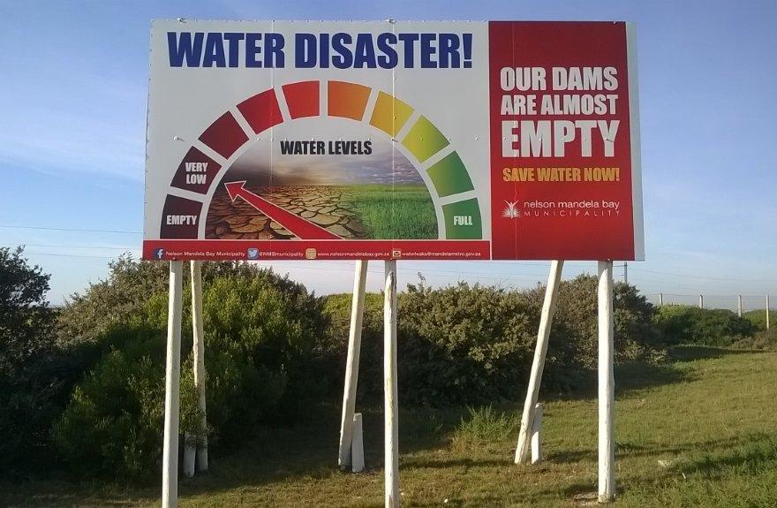
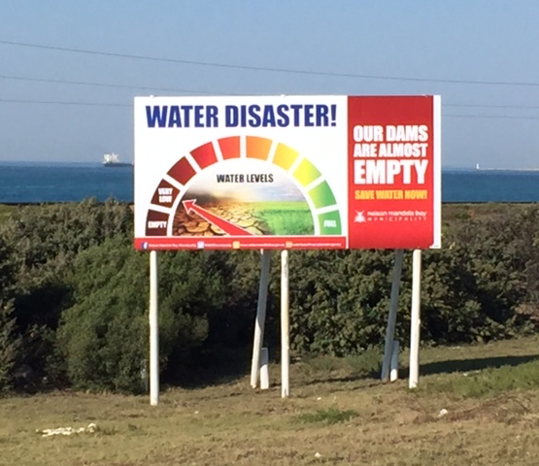
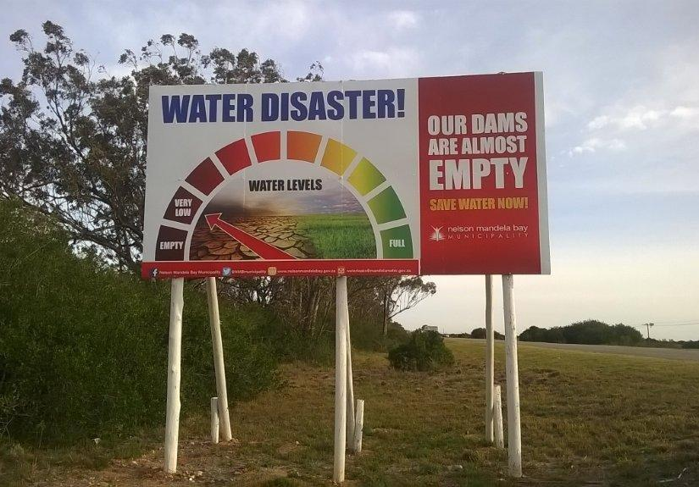
Drought Awareness Campaigns

Slide 18
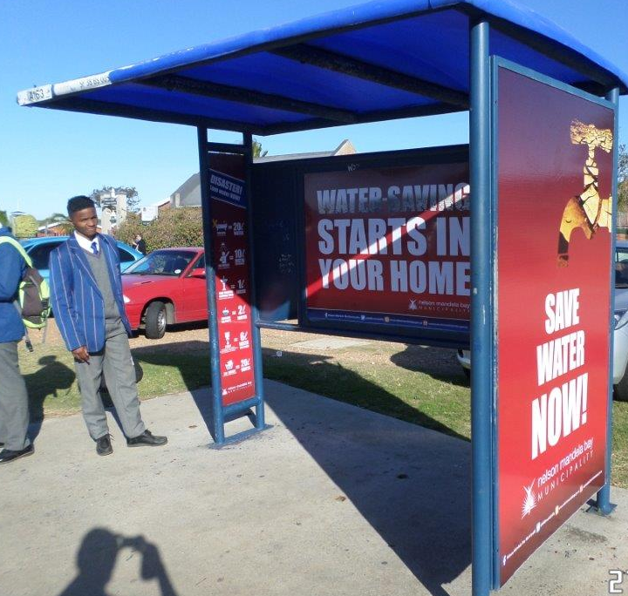
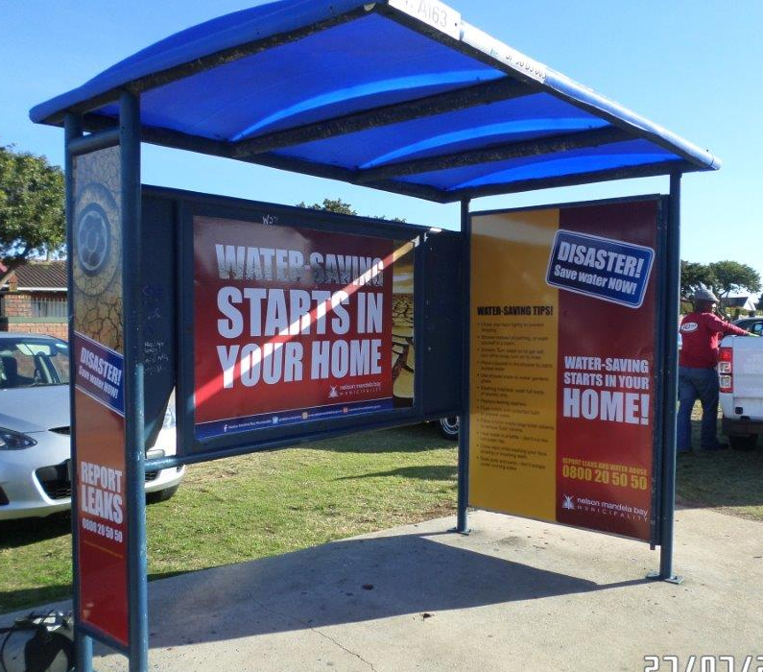
Drought Awareness Campaigns

Slide 19
11.2 WC/WDM at NMBM
8.1 NMBM water requirements
11.1 NMBM Drought measures and progress with implementation
11.2 WC/WDM at NMBM
11.3 Nooitgedagt Low-level Scheme Implementation and Financing
11.4 Desalination of Sundays River irrigation return flows.
11.5

Slide 20
11.2 WC/WDM at NMBM

Slide 21
11.2 WC/WDM at NMBM
WC/WDM Focus Areas:
  Zoning
  Pressure reduction.
  Meter replacement.
  Pipe replacement.
  Leak repairs:
    Contractor support.
    Recruitment of additional plumbers (13 recruited in the last 12 months).

Slide 22
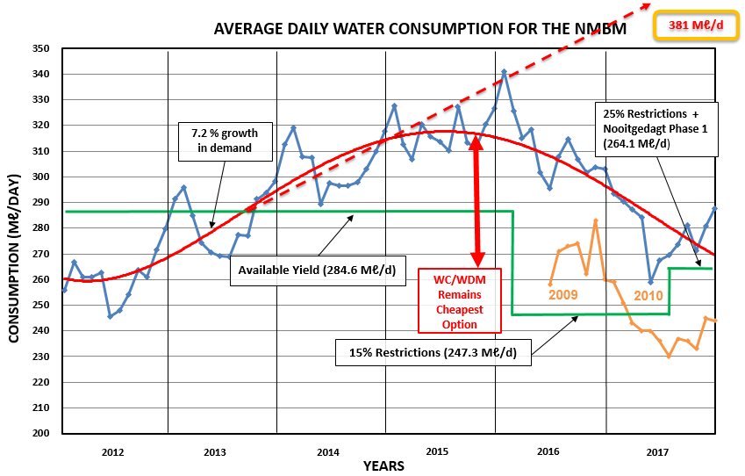

Slide 23
11.3 Nooitgedagt Low-level Scheme Implementation and Financing
Phase2:
  99% complete
  140Ml/day available since July 2017.
Phase3:
  30% complete.
  2 Major delays:
    Health & Safety
    Non Payment
  Funded from NT and DWS through Amatola Water as per DORA
  Anticipated completion date February 2020.

Slide 24
11.4 Desalination of Sundays River irrigation return flows.
NMBM:
Limited Feasibility study conducted.
Volumes of water not enough for long term solution.
Water to be transferred to western side of Metro where problem/shortage during droughts exists.
Huge financial costs associated (±R500M)
Awaiting outcomes of the feasibility study by DWS as agreed in meeting before NMBM can proceed.

Slide 25
11.5 Re-use of water treated to industrial standards:
Fishwater Flats WWTW:
  Currently limited industrial re-use being utilised especially in the Deal Party industrial area.
  110Ml/day Re-use scheme for Coega IDZ planned.
    60Ml/day from FWF WWTW
    50Ml/day from Coega WWTW.
  Coega IDZ EIA approval stipulates Re-use of treated water for Coega industrial use. Estimated cost of R600mil.
  NMBM does not have these funds available.

Slide 26
11.5 Re-use of water treated to industrial standards:
Coega WWTW:
  Feasibility studies completed.
  Potential plant size of 110Ml/day.
  Plant required for the ultimate full development of the Coega IDZ.
  Plant broken into industrial and domestic lines due to effluent variances in quality.
  Motherwell North development and sewer line to support commissioning of plant.
  Estimated cost of WWTW is R3bil.
  NMBM does not have these funds available

Slide 27
11.6 Groundwater - Coega kop implementation
Coega Kop aquafer is the best possible groundwater potential.
EIA approval for 25Ml/day of groundwater abstraction.
Implementation:
  Phase1 - feasibility study complete.
  Phase2 - Exploration boreholes drilled.
  Phase3 - Production borehole contract and relevant pipelines commenced. (R55M).
  Phase4 - Construction of 20M/day water treatment plant to commence within 2019. (R160M).

Slide 28
11.7 Other groundwater schemes & drought initiatives
Water Augmentation:
  Churchill Dam
  Kamesh Reservoir
  Moregrove Fault
Drought Augmentation:
  Borehole drilling to support swimming pools
  Provision of non potable water points throughout the NMBM
  30 Wards @ 3 boreholes each when required.

Slide 29
11.8 NMBM 60 Ml/d Desalination Scheme
Feasibility study nearly complete and finalised.
Site determined through a Multi disciplinary Criteria Method
Planned for construction in phases up to 60Ml/day.
Estimated cost of R3bil.
NMBM does not have the funding available.
  Funding and procurement model need assistance.

Slide 30
11.9 Marina Sea Salt Desalination Scheme
Marina Salt approached NMBM with possible potable water provision through their construction of a sea water desalination plant.
26Ml/day potentially available for usage.
NMBM currently investigating the contractual and legal implications of an agreement between the two parties, Marina Salt & NMBM.
  Appears that National Treasury / Minister determination is required.

Slide 31

SAVING WATER HAS TO BECOME A WAY OF LIFE
  THANK YOU
  “KEEP IT FLOWING IN THE PIPE”

